Slide 1

EEM 343 Robotics Presentation
Cheah Kai Bin 139462

Slide 2
Problem definition
Rice as one of the main sources of nourishment for over half of the world’s population.
However, the transplant of seedlings is not an easy job as every seedling should be spaced for a suitable distance to promote growth, and the process is both tiring and not efficient.
rice transplanter ready in the market, most of them are bulky and cost consuming,

Slide 3
proposed solution
A dual robotic arm platform can be used to perform the task mentioned.
It has 2 arms that faced both directions, can pick up seedlings from the container and transplant it into flooded paddy field.

Slide 4
methodology
Dynamic analysis equation
Spawn in Rviz
Control robot in Gazebo from Rviz
Change to urdf files
Solidworks
Enable joints and controllers in code

Slide 5
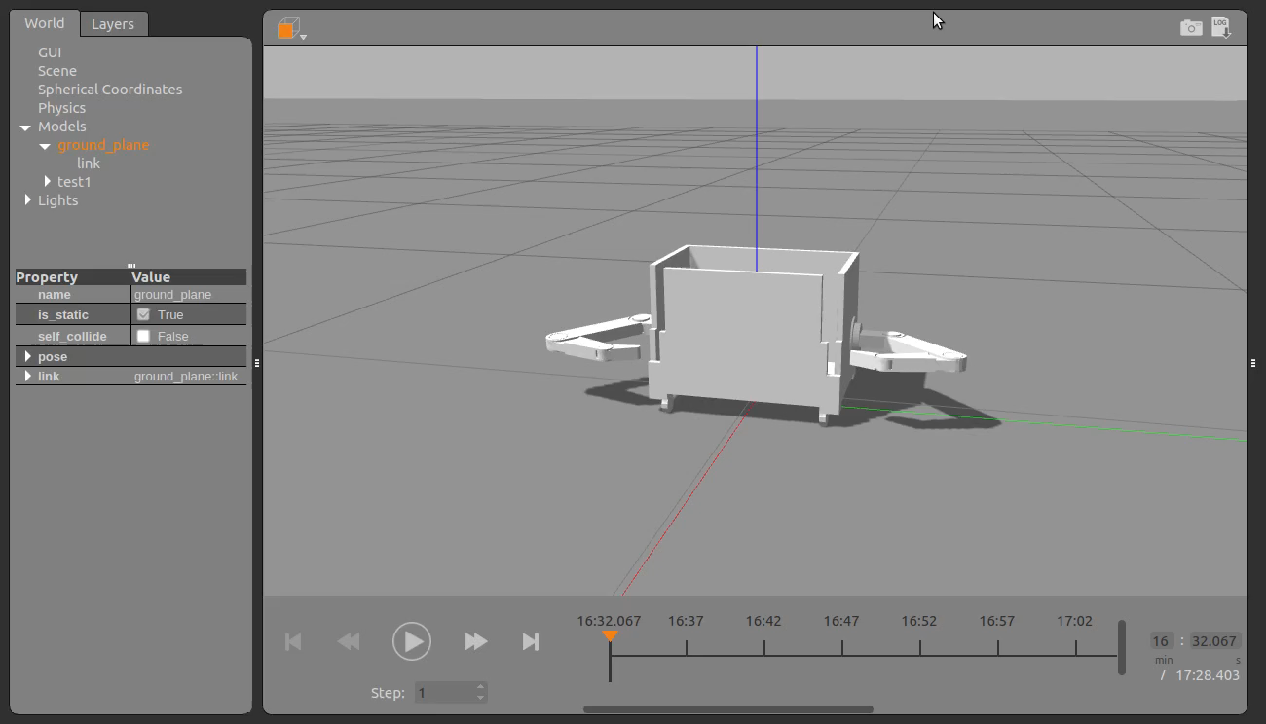
Simulation demonstration

Slide 6

impact on sustainability and environmental
lower production cost and maintenance fees
Autonomous, reduce total manpower needed.
surpass normal worker in terms of speed and accuracy, increase efficiency.
leaves low level to no carbon footprint, does not emit any smoke (environment friendly)

Slide 7
Possible future planning
A more detail design on clippers can be created and shown in model. For current model only the robotic arm part and its movement are shown.
The pick-and-plant technique should be more smoother and faster with more complex joint such as ball-and-socket joint or saddle joints.
Container with build-in compress system that enable the arm to always pick up the seedlings.

Slide 8

END

